Slide 1
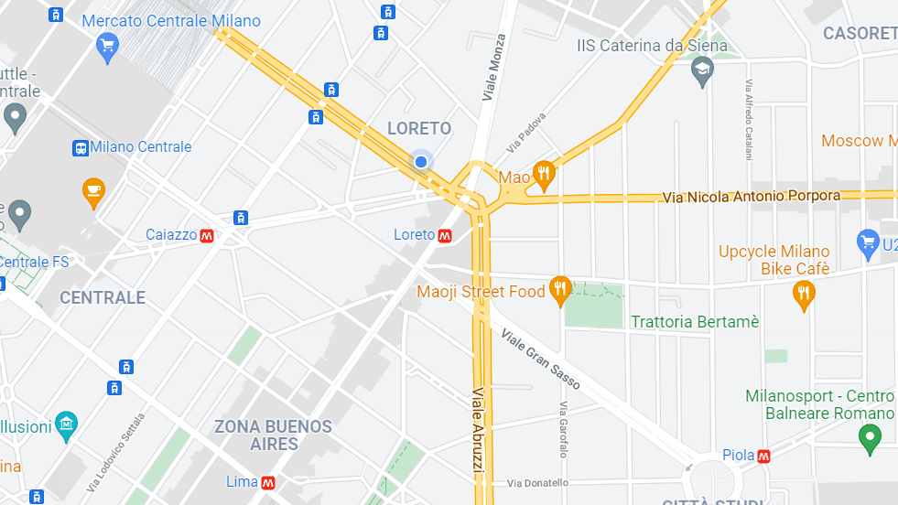



DESIGN AND IMPLEMENTATION OF MOBILE APPLICATIONS
URBANHUNT
Francesco Gonzales, Lorenzo Mainetti

Slide 2
TABLE OF CONTENTS
01
02
03
CONCEPT
UI/UX DESIGN
ARCHITECTURE
04
05
TESTING
CONCLUSIONS
App idea and
main functionalities
Frontend elements design, logo and UX design
Architectural choices,
API and packages
Testing campaign
Takeaways and next steps

Slide 3



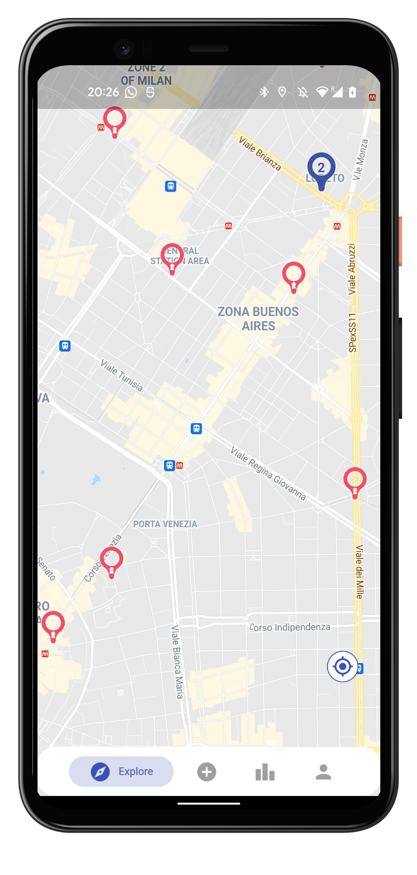
CONCEPT
EXPLORE
COMPETE
URBANHUNT
CONTRIBUTE
01
Find and unlock new uncommon places
Compete on a national or global leaderboard gaining points when unlocking places and contributing
New paradigm in how visitors can explore cities
Suggest new uncommon places that only you know

Slide 4



UI ELEMENTS DESIGN
02

Slide 5
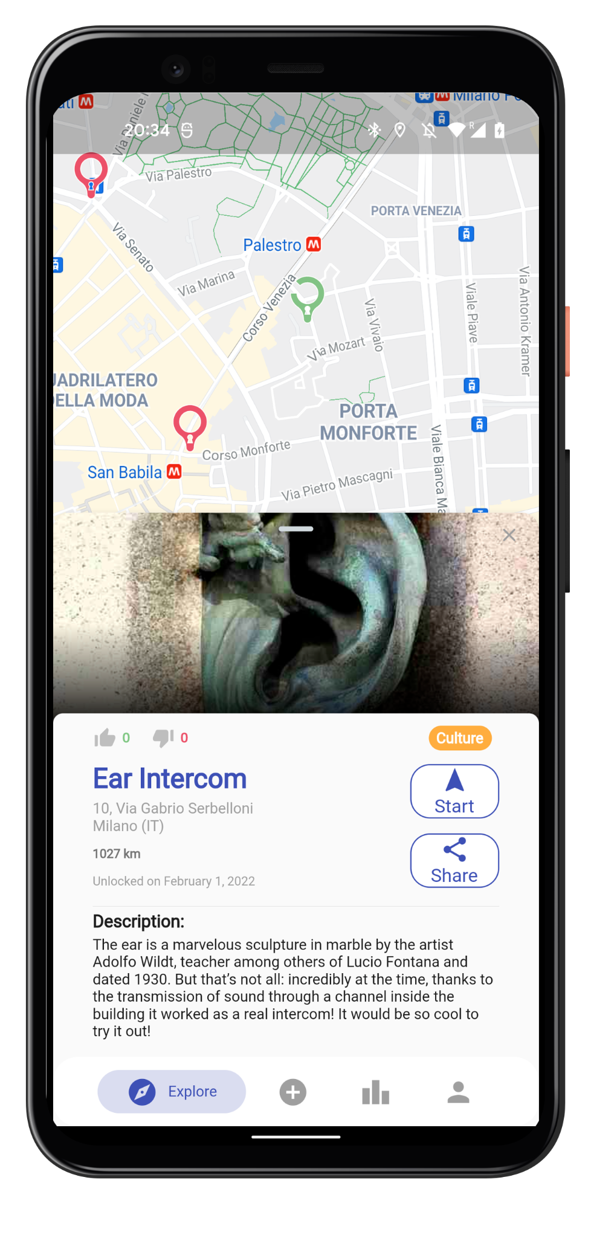
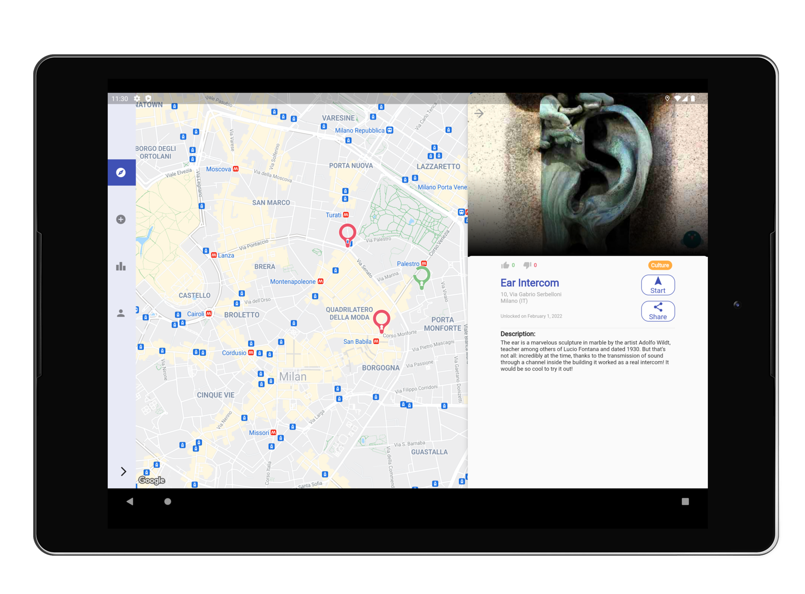
02
MOBILE LAYOUT
TABLET LAYOUT

Slide 6
Infer country using API
UX DESIGN:
The devil is in the details
When user has GPS off, he can still interact with the app with limited functionalities
Both the marker icon and the cluster icons are customized
Markers on the map are clustered
On sign up, log in directly without waiting for email verification
The password field is visible only if the user is authenticated with EmailAuth provider
If email is not verified, the user cannot unlock a place or contribute
Different authentication methods are merged if have common email address
Images are cached to speed up the app
02
Notes:
The complexity of our app lies in many little details that improve the user experience and the fact

Slide 7







ARCHITECTURE
03
APIs
Server
Flutter
Firebase
Database
Users
Frontend
Backend
Notes:
The fundamental architectural blocks are the frontend, implemented in Flutter, and a serverless backend that leverages Firebase services.
Furthermore we used external APIs such as ip-api, Maps API and Places API, besides the authentication APIs such as Google and Facebook Login.

Slide 8

WHY LUTTER
RICH ECOSYSTEM
LOOK AND FEEL
CROSS-PLATFORM
03
Besides having a lot of prebuilt UI components, it also has a rich packages ecosystem.
Unified UI design across platforms providing consistency between apps.
Supports both Android and iOS, reduces development and maintenance costs while being highly performant..

Slide 9




WHY FIREBASE
STORAGE
AUTH
FIRESTORE
FUNCTIONS
03
Store files like images and videos
Authenticate your users
NoSQL database
Serverless backend

Slide 10
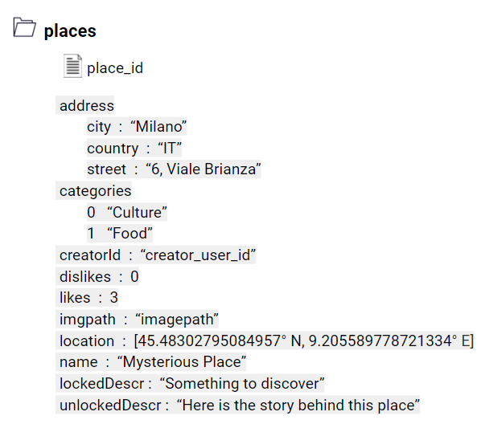


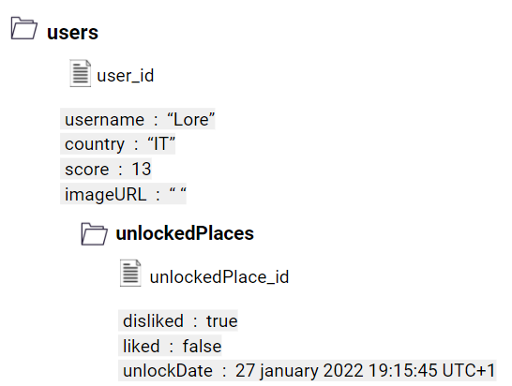
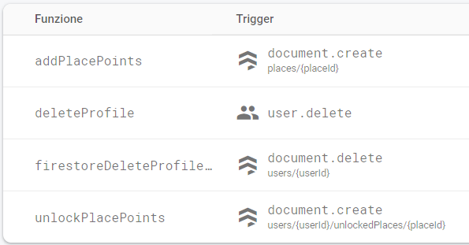
WHY FIREBASE
STORAGE
AUTH
FIRESTORE
FUNCTIONS
03
Store places and profile pictures.
Integrated with Google Login and Facebook Login.
Cheap and efficient scaling.
Run backend functions in response to events triggered by Firestore and Auth.

Slide 11
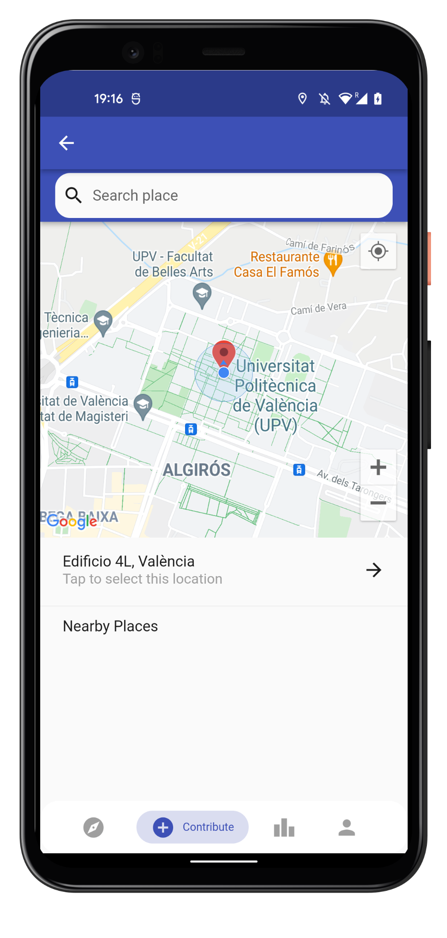
APIs & PACKAGES
03
APIs
Maps API
Places API: information about places of interest
Google Login
Facebook Login
ip-api: from IP address get location
“There’s a plugin for that!”
Geolocator: location and accuracy radius based on information about cell towers and WiFi nodes
Clustering: google_maps_cluster_manager
Pickers: image_picker, place_picker, country_picker
Testing: mockito, firebase_auth_mocks, firebase_storage_mocks, google_sign_in_mocks

Slide 12
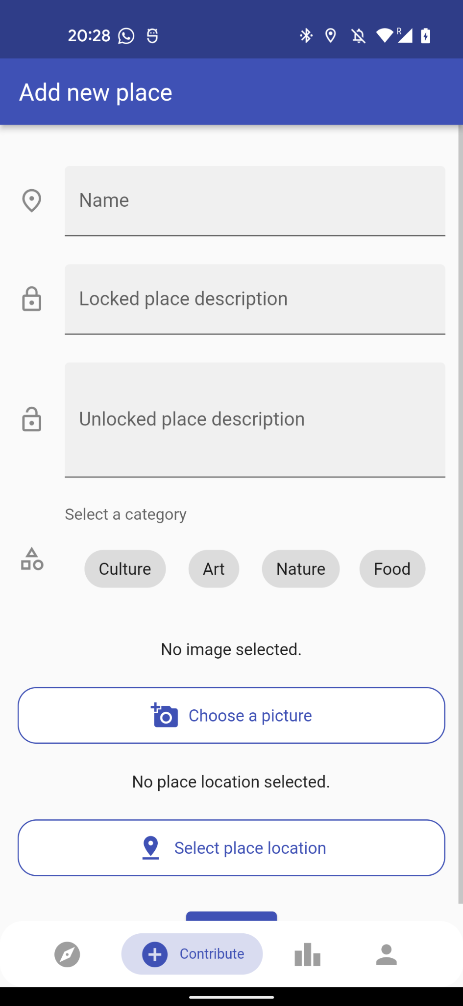
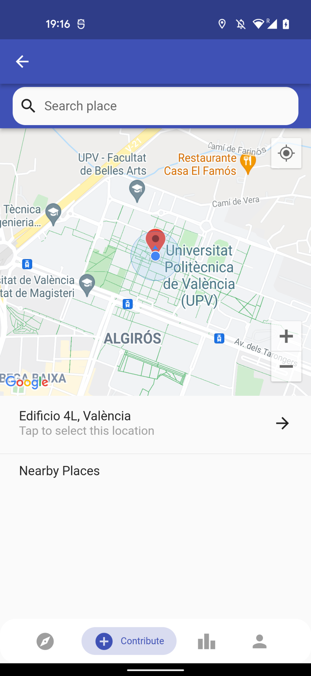
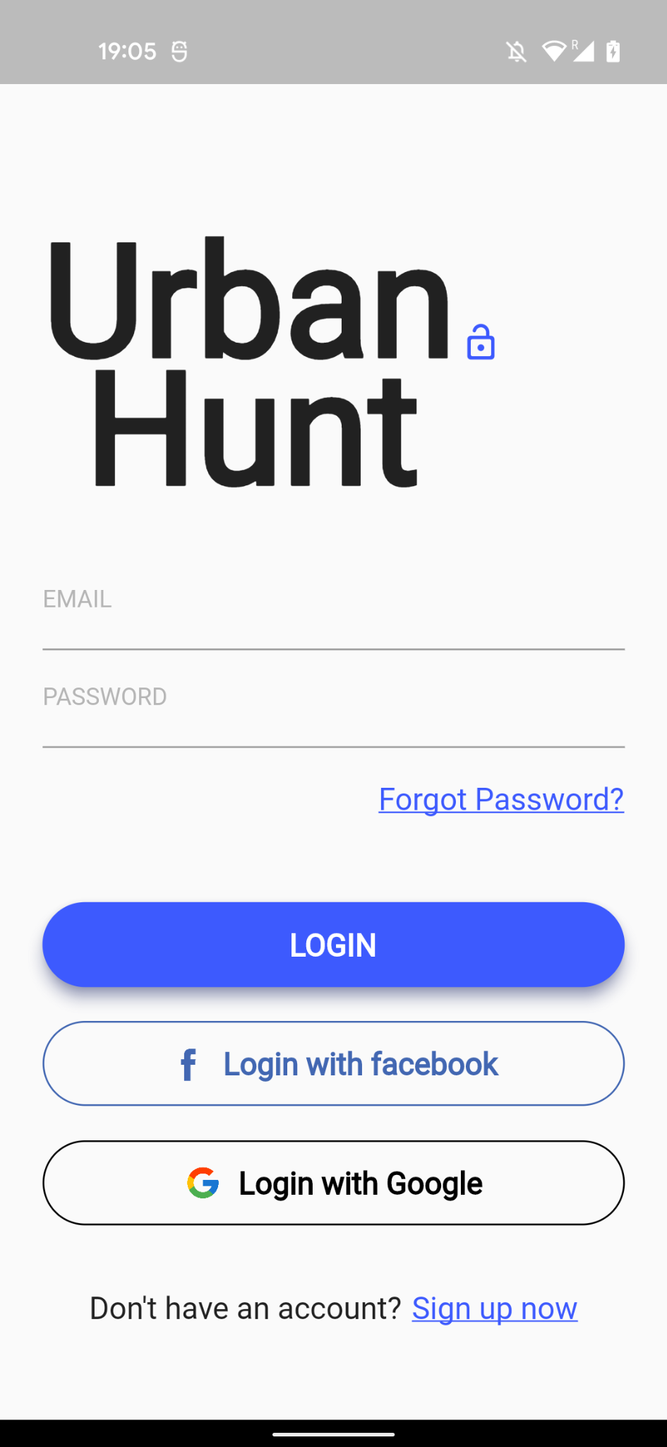
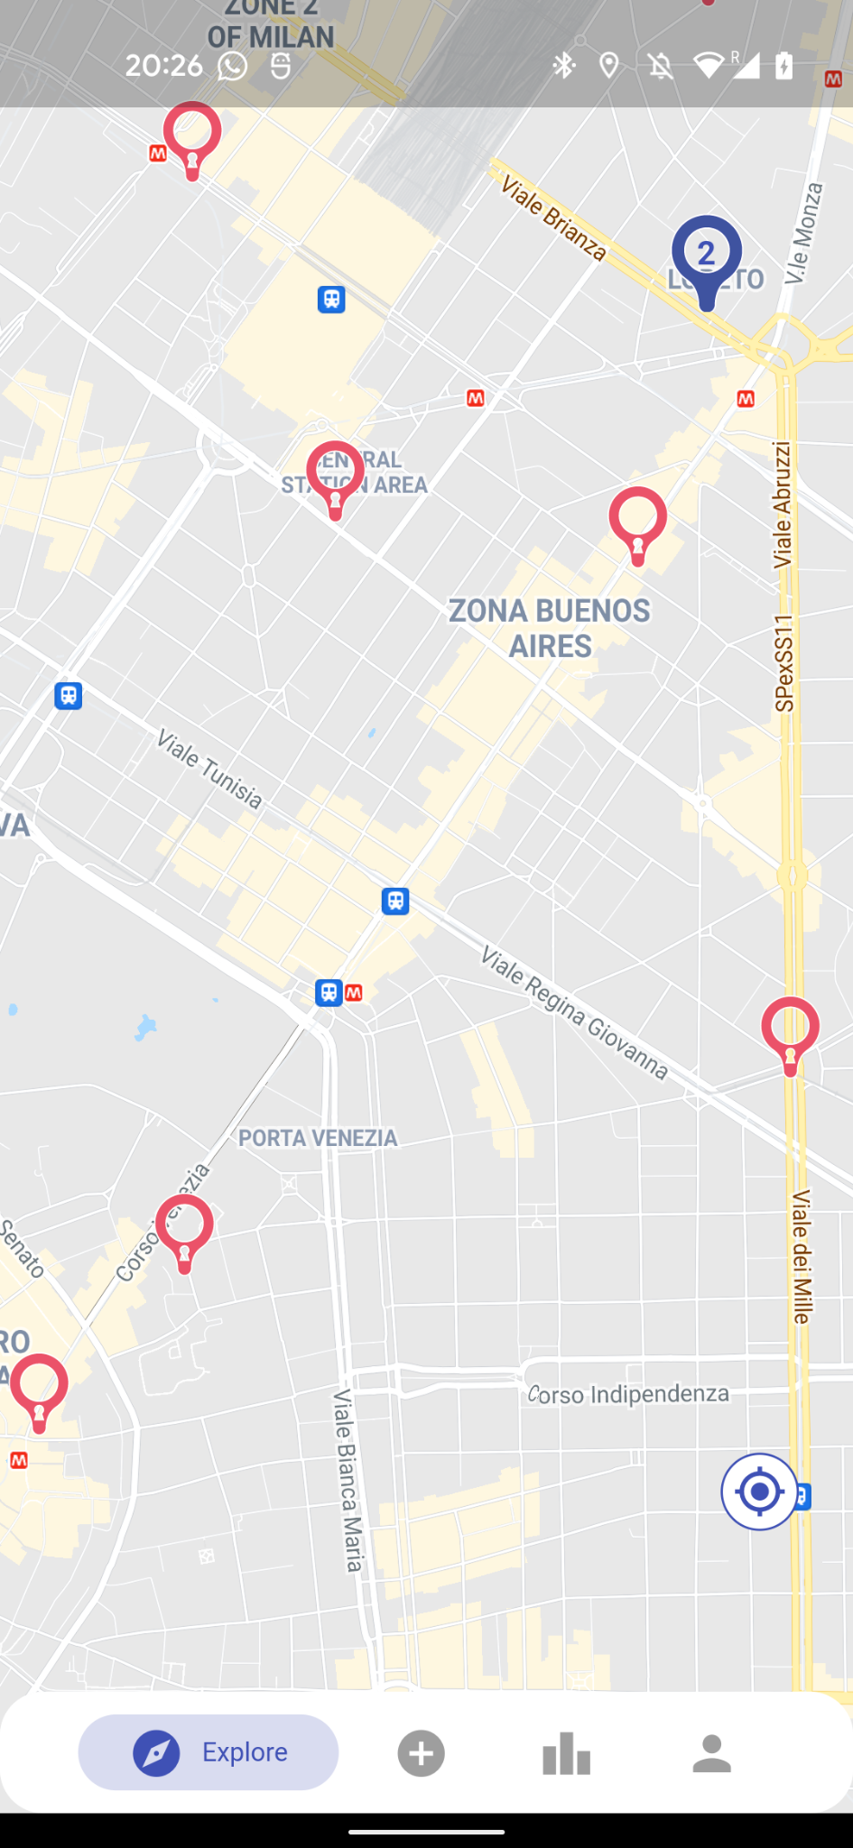
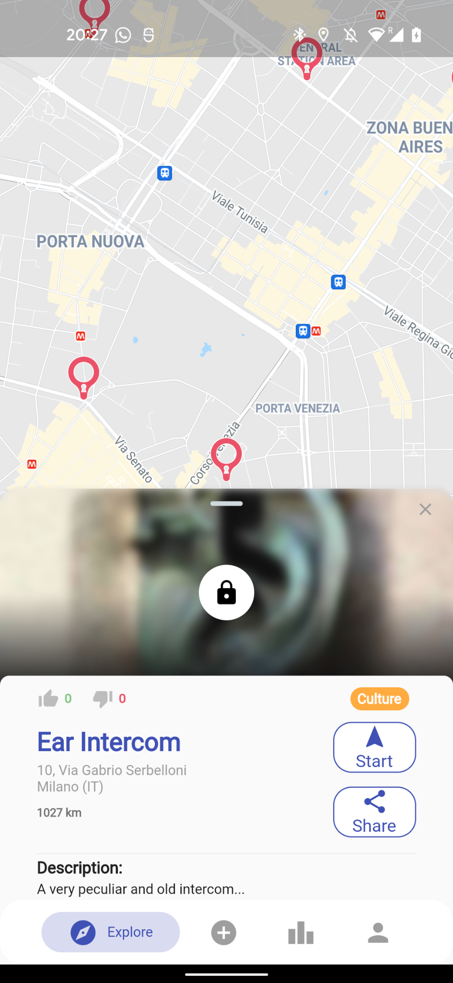
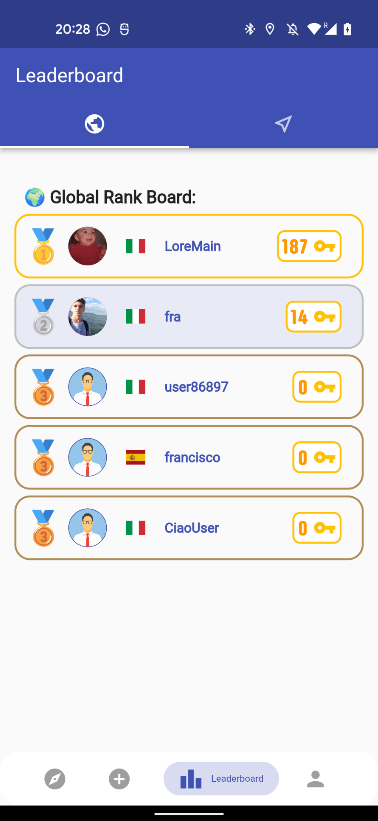
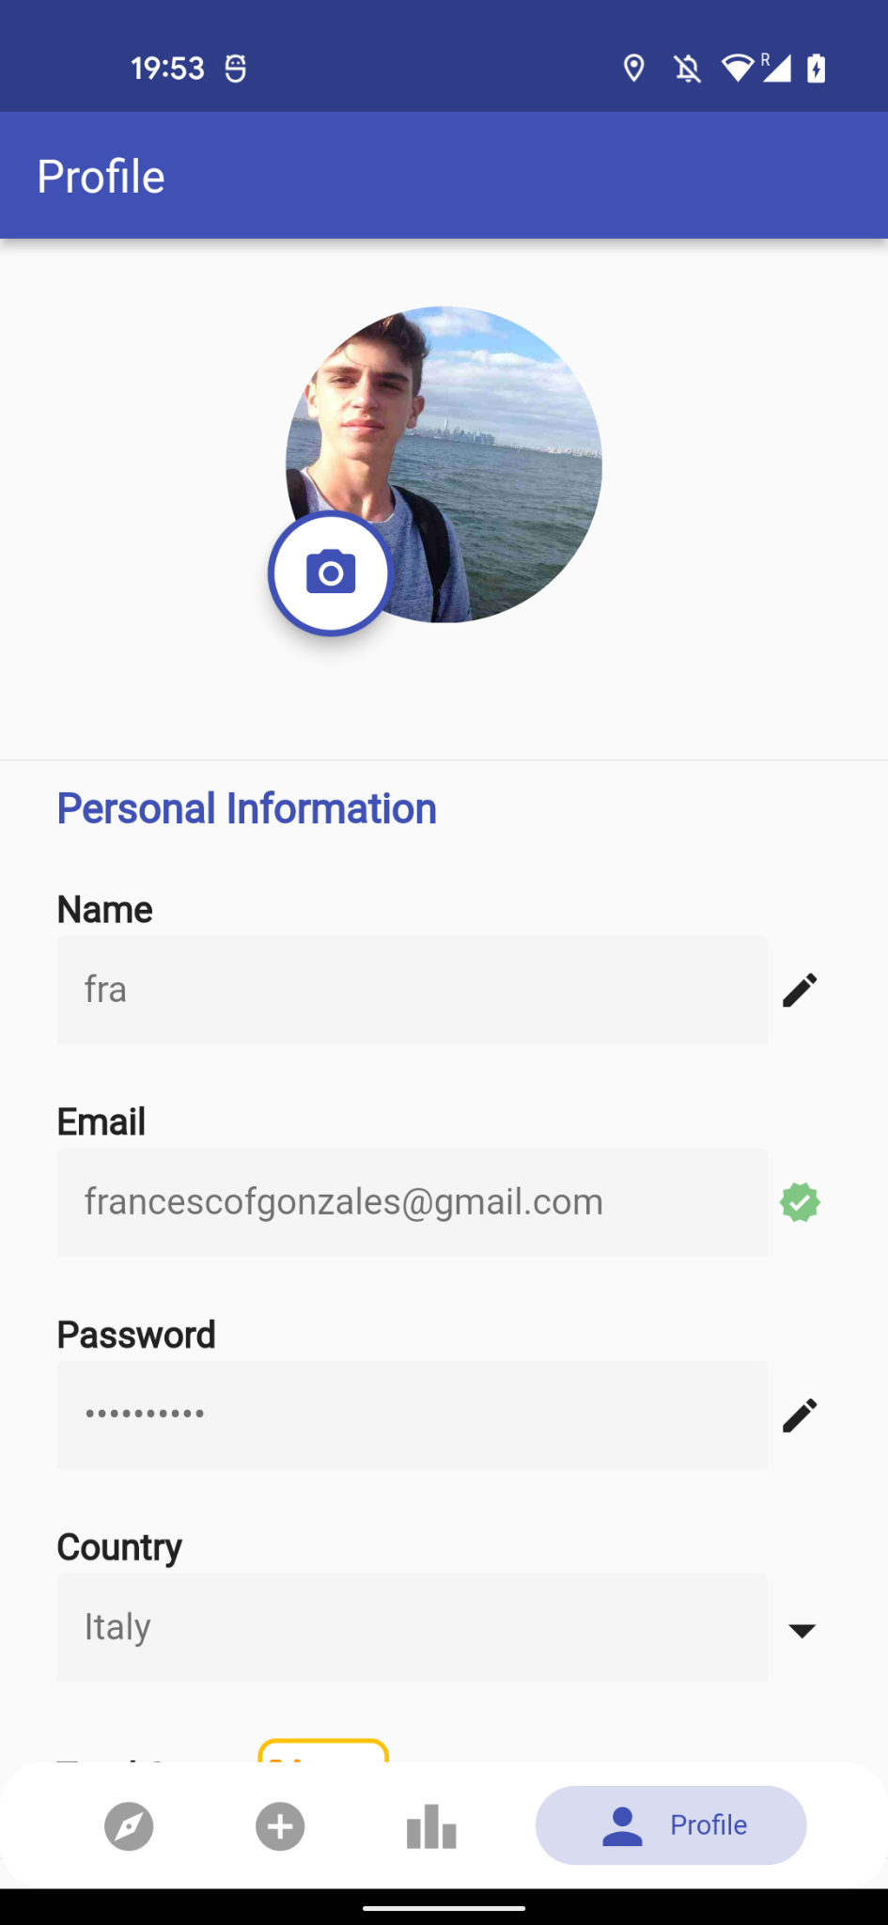
ARCHITECTURE
03
Maps API
Places API
Maps API
Notes:
Going deeper and opening up these black boxes, we can see that we have several pages that interact with different services.
SIGN UP At first the user signs up, and at this point ip-api infers his country.
SIGN IN Then he logs in thanks to firebase auth and accesses the explore page
EXPL Which uses data from google maps API to render the map, and firestore to retrieve place data
CONTR Navbar gives access to the contribute page, where users can enter data about the new place, including a picture, which is stored on firebase storage.
PL PICKER: to let them easily add a new place we get data for autocomplete from places API
PLACE:
LEAD: selecting leaderboard from the navbar.. Global or national from ip-api
PROFILE: talks to firestore to edit data and storage for the picture, and auth for the password

Slide 13
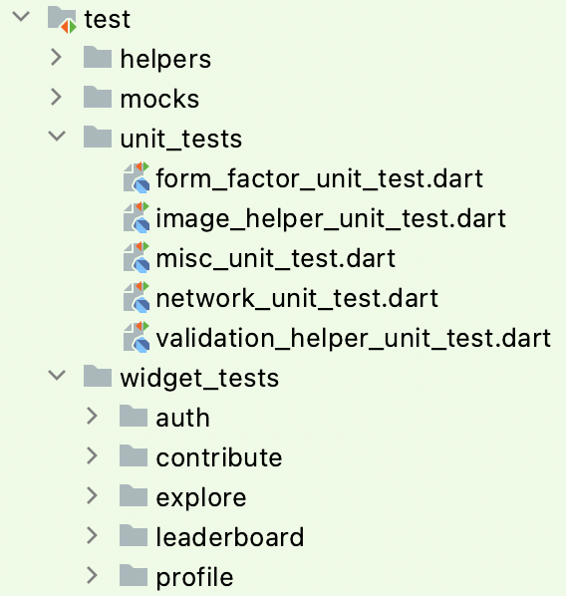
TESTING
04
88 automated tests performed
Unit testing: 38 tests
Widget testing: 50 tests
Used Mocking libraries we mocked the Firebase dependencies and we were able to test the main functionalities.
The integration between Firebase and the application was mainly tested through debugging.

Slide 14
CONCLUSIONS
05
FRAMEWORK
Flutter is great for fast development, but the code can get messy and requires getting to know many components.
ENVIRONMENT
Firebase is great all around, requires minimal setup and does its job.
Android Studio and emulators, although being fully featured, they still have several bugs that impact the developer experience.
EXPERIENCE
Overall, being inexperienced in mobile development, it was a challenging project, due to the complexity of the system and the multitude of edge cases. It was still a great learning experience.

Slide 15
THANKS!
Q&A
UrbanHunt

